Slide 1
職場故事

Slide 2
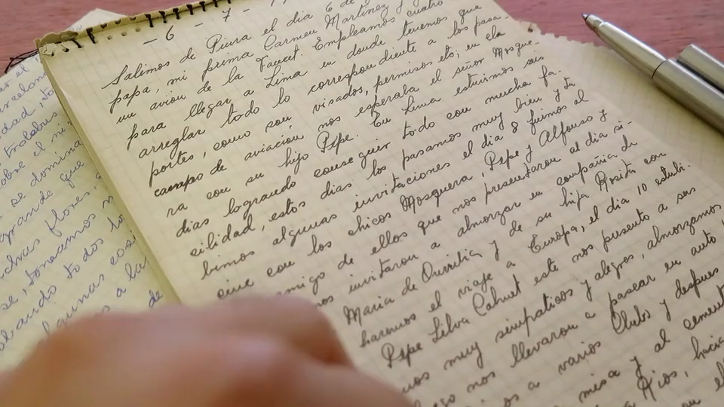
1. 目標
Notes:
https://pixabay.com/videos/text-writing-document-page-writer-41146/

Slide 3
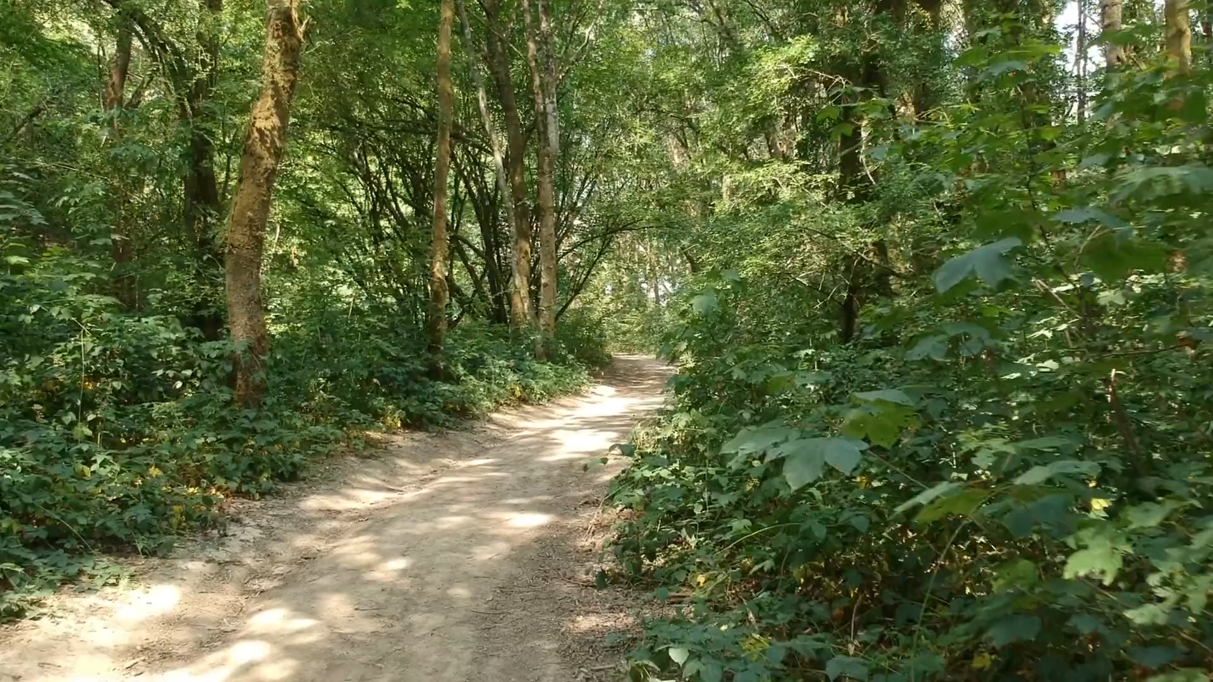
2. 阻礙
Notes:
https://pixabay.com/videos/forest-trees-walkway-46906/

Slide 4

3. 努力
Notes:
https://pixabay.com/videos/antique-book-book-opening-111280/

Slide 5
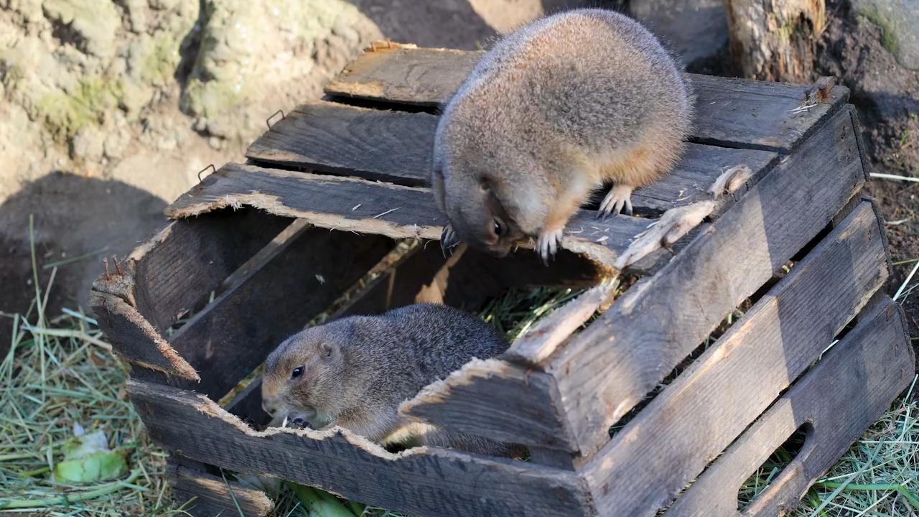
4. 結果
Notes:
https://pixabay.com/videos/rodent-box-nibble-wood-scratch-135086/

Slide 6

5. 意外
Notes:
https://pixabay.com/videos/rock-balance-stacked-rocks-balance-42470/

Slide 7

6. 轉彎
Notes:
https://pixabay.com/videos/ai-generated-book-literature-188710/

Slide 8
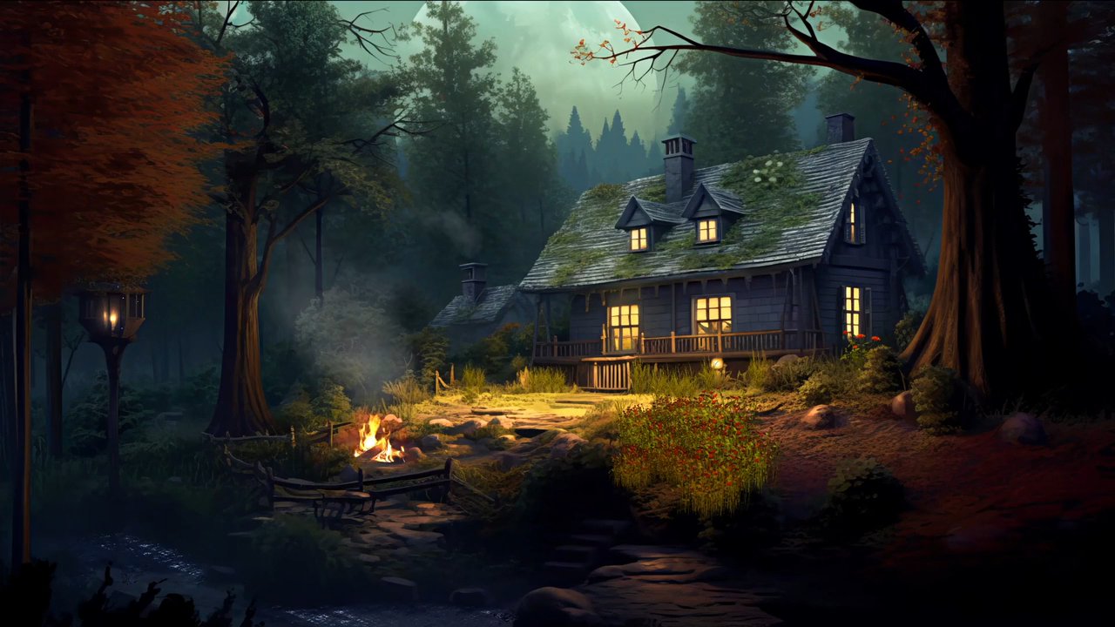
7. 結局
Notes:
https://pixabay.com/videos/ai-generated-house-cabin-bonfire-180074/

